Slide 1
GFF portfolio update
SECOND INVESTORS GROUP, St Albans, United Kingdom, 17-18 February 2016

Slide 2
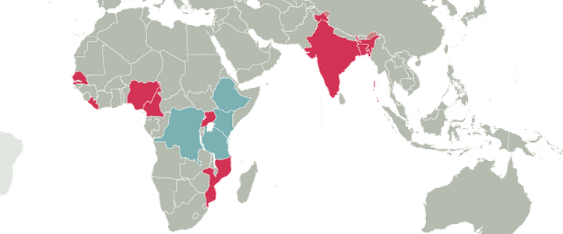
GFF portfolio
Frontrunners: DRC, Ethiopia, Kenya and Tanzania
Second wave: Bangladesh, Cameroon, India, Liberia, Mozambique, Nigeria, Senegal, and Uganda

Slide 3
Country status at a glance
Pioneers: Tanzania, Kenya
Focused on national strategies first: DRC, Ethiopia
2015
2016
Second wave quick starters: Cameroon, Liberia, Uganda
Early 2016: Bangladesh, Mozambique, Senegal
Determining approach: India, Nigeria

Slide 4
DRC
Country platform
Building on existing multi-partner platform
Investment Case
Based on health sector strategy
Two priorities: addressing systems bottlenecks (human resources for health, supply chain/drugs, and public financial management); and achieving increased coverage of essential RMNCAH services at an affordable cost and prioritizing underfunded family planning and nutrition interventions
Draft expected March 2016
Strong commitments for complementary financing, building on existing platform with Gates Foundation, Gavi, the Global Fund, UNFPA, UNICEF, and the World Bank
Other support from Canada, Norway, US
IDA: US$220 million existing, US$100 million additional (Q4 2016), US$10 million CRVS (Q1 2016; as part of governance project); GFF Trust Fund: US$50 million
Health financing strategy
Health financing assessment completed
Drafts of several elements prepared but several important areas (e.g., pooling, purchasing) still under development
Finalization expected June 2016

Slide 5
Ethiopia
Country platform
To be confirmed at the upcoming Joint Consultative Forum (March), but likely to build on existing Joint Core Coordination Committee
Investment Case
Likely to be a short annex based on Health Sector Transformation Plan
Addressing equity and improving quality of care are likely to be priority focus areas
Family planning, nutrition, and adolescent health are all well reflected in the HSTP and multi-sectoral linkages with WASH and education also emphasized
Strong interest in complementary financing, including from DFID, the Global Fund, the Power of Nutrition trust fund, and USAID
IDA: US$258 million (likely not until 2017); GFF Trust Fund: US$60 million
Health financing strategy
Draft under review
Health financing a key issue (both social health insurance for formal sector and community health insurance for non-formal sector)

Slide 6
Kenya
Country platform
Using RMNCAH TWG for Investment Case and Health Financing TWG for the health financing strategy
Investment Case
National Investment Framework for RMNCAH in process of being published
Identified 20 target counties as priorities
Given decentralization, focus is currently on planning/prioritizing with counties
Strong support, including from governments of Denmark, Japan, UK, and US
IDA: US$150 million (Q2 2016); GFF Trust Fund: US$30-40 million
Health financing strategy
Has been a longstanding process
Goal: increase access to outpatient and inpatient health care for all Kenyans and to reduce the out-of-pocket expenditures
Five key areas: resource mobilization; purchasing; benefits definition; accreditation and licensing; and governance

Slide 7
Liberia
Country platform
RMNCAH technical working group developing Investment Case, health financing TWG for the health financing strategy
Investment Case
Draft Investment Case being revised (including based on revised costing)
Four priorities
Quality EmONC and adolescent/youth-friendly RMNCAH service delivery
Emergency preparedness, surveillance and response (esp. maternal and newborn death surveillance and response)
Sustainable community engagement
Enabling environment: leadership, governance, and management
Discussions on complementary financing now underway, including with Global Fund and US
IDA: US$16-23 million (Q2 2016); GFF Trust Fund: US$16 million
Health financing strategy
Existing financing strategy provides starting point but is in need of updating and complementing with an implementation plan that has prioritized actions
Key areas of interest include health equity fund and donor pooling

Slide 8
Tanzania
Country platform
Development Partners Group acts as country platform, with technical sub-groups on RMNCAH and health financing
Investment Case
One Plan II used as Investment Case
Implementation began in 2015
Complementary financing from USAID (US$40 million) and nutrition fund (US$20 million)
IDA: US$200 million (Q2 2015); GFF Trust Fund: US$40 million
Health financing strategy
Close to finalization but has been slowed down because of the transition to a new government
Will require parliamentary approval

Slide 9
Uganda
Country platform
Using an existing health sector coordination mechanism
Investment Case
Draft Sharpened RMNCAH Plan serves as the basis for the Investment Case (which will be annex to it)
Emerging priorities:
Skilled birth attendance (focused antenatal care, labor and delivery management and immediate postpartum care)
Family planning (including preventing teenage pregnancy)
Post abortion care and maternal sepsis management
Delivery of an integrated RMNCAH community package
Discussions are underway around complementary financing, including with Gavi and USAID
IDA: US$110 million (Q2 2016); GFF Trust Fund: US$30 million
Health financing strategy
Underway for several years, but stalled until the elections

Slide 10
Other countries
Bangladesh: launched end of January
India: government still determining its involvement with the GFF; decision expected by the end of February
Mozambique: launch expected in March
Nigeria: determining most appropriate approach/scope (particularly national vs. state level)
Senegal: launched beginning of February

